Slide 1
STUDENT GUIDELINES
This is for student participants and observers at the NW Parli Warmup

Slide 2
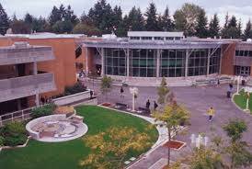
Welcome to our Community’s Tournament
We hope
you have a fun and
educational tournament
We want to provide great hosting
Food, drinks, community connections
Great rounds
If you need something, just ask
Have a great tournament . . .

Slide 3
As a speaker-debater . . .
We want a great, educational tournament
You may not consume nor be under the influence of alcohol or illicit drugs . . .
  At the tournament on campus
Alcohol and illicit drugs may not be near you—you must leave any such area
Even if you are over 21
It applies to ALL schools and participants
It is the right thing to assure a safe, comfortable environment
We want and expect a professional tournament, one we can be proud to show to administrators.

Slide 4


Socialize fun and safe
Create social get-togethers without alcohol and illicit drugs
Watch a movie
Hang out talking
Chill with a juice, soft drink,
water
Never drink alcohol excessively
And some good snackies!

Slide 5

Be at your round on time
Be checking postings.
Please use the bathroom, take your breaks before prep time-debates-speeches start so you are ready to go.
Leave prep rooms/team gatherings with plenty of time to arrive on schedule.
Start the first speech on schedule.

Slide 6

Treat Classrooms with respect
Show respect to the School and Staff.
Avoid loud noises (interrupts classes).
ALWAYS be courteous and cooperative
with security.
Do not take nor move tech items (keyboards, mice, power cords, etc.) from rooms.
Move furniture?
  Do it carefully
  Return it at the end of the round
Room clean at the end of the round?
Help out.

Slide 7
Be inclusive
Encourage everyone to participate.
Be open to differences
  Lesbian-Gay-Straight-Bi-Queer
  Black-White-Latino-Asian-Biracial-
  Multiracial, etc.
  Men-Women-Trans-Androgynous-etc.
  Republican-Democrat-Libertarian-etc.
  Catholic, Agnostic, Mormon (LDS), Muslim, etc.
  Disabilities--diagnosed or otherwise?
  Military service?
  Other identities?
  Treat every student,
  coach, and judge with respect.

Slide 8
It is about respecting each other
Participants including students, judges, and coaches:
  should express their opinions about issues.
  should not attack groups of people.
  should not attack other individuals.
Debaters and Speakers should argue about ideas—not disrespect people.

Slide 9
Treat each other right
Treat people kindly
Support an inclusive Northwest environment
Avoid mean comments
Avoid sexualized comments
Avoid inappropriate physical conduct
Avoid actions and words that harass on the basis of race, gender, etc.

Slide 10
If you see or hear about harassment . . .
Whether it is done by a
  Coach
  Judge
  Debater
  Observer
  Anyone participating or attending the tournament . . .

Slide 11
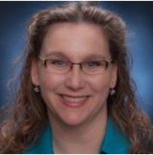
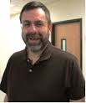
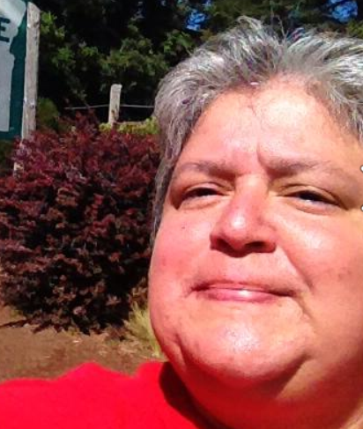
If you see or hear about harassment . . .
Stop it if possible
Share the information about it . . .
with your coach OR
Share it with Denise Vaughan
Share it with Jim Hanson
Share it with Shannon Valdivia
We’ll work to make
things better.

Slide 12
Share the Information ASAP Pt 1
Don’t delay; communicate . . .
  “I don’t want to get someone in trouble”
  Our goal is to work out the problem in a constructive manner. Please share it.
  “It wasn’t that big of a deal”
  It might have been; we need to make sure. Please share it.
  “People need to get over their sensitivity”
  Please show support for people’s feelings; there may be a good reason they are sensitive to what happened. Please share it.
  “I got it worked out”
  That’s great but we need to check and make sure. Please share it.
  TRY TO STOP IT and SHARE THE INFORMATION WITH YOUR COACH, DENISE VAUGHAN, OR JIM HANSON AT THE TOURNAMENT SO WE CAN ADDRESS IT.

Slide 13
Share the Information ASAP Pt 2
Don’t delay; communicate . . .
  “I’m scared to report”
  Understood. We’re here to support you. Take that step and help make our community a safer place. Please share it.
  “Not a debater”
  It still affected someone at the tournament. Show support for all people, not just speech and debate community members. Please share it.
  “I’m not a top ten debater; the person is. I don’t have the clout to share this information.”
  Yes, you do. Everyone participates at the NW Parli-IE Warmup and everyone has a right to a safe, comfortable, supportive environment. Please share it.
  TRY TO STOP IT and SHARE THE INFORMATION WITH YOUR COACH, DENISE VAUGHAN, OR JIM HANSON AT THE TOURNAMENT SO WE CAN ADDRESS IT.

Slide 14
Sharing Information Means . . .
We’ll work to determine the best course of action
We’ll work to make things better.

Slide 15
As a speaker and debater . . .
People look up to you.
You are setting the stage for this year’s NW Speech and Debate Community.
Other speakers and debaters are going to emulate you.

Slide 16
Be the speaker people talk about as . . .
“Yea, Elda’s cool; helped me out on a a great speech.”
“I respect him a lot. He could argue T like nobody’s business and he reached out to younger debaters and made them feel included.”
“She’s wicked smart but also really, really nice.”

Slide 17
Don’t harass; Stop the harass
Reach out to include people
Don’t exclude and hurt others
Don’t engage in sexual harassment even unintentionally . . .

Slide 18
So you don’t harass others . . .
Keep compliments casual and avoid personal issues/private issues.
Avoid jokes, words, phrases, obscene gestures with sexual meanings and definitely not sexist, racist, etc. jokes.
Keep your hands to yourself. Avoid touching.
Don’t talk about sex during labs and practice sessions.
Don’t assume that a friendly person is interested in a sexual/romantic relationship with you. Assume only that friendly people are friendly.

Slide 19
So you don’t harass others . . .
Respect the personal space of others and don’t gossip about others.
Don’t focus attention on one individual (e.g. gifts, lots of practice with just one person, etc., following someone around).
Don’t make jokes or comments that disrespect or belittle a person. Don’t bully people.
Ask if something you do or say is being perceived as offensive or unwelcome. If you don’t get a clear confirmation your actions are okay, stop the behavior.
Don’t interpret someone's silence as consent. Look for other nonverbal signals.

Slide 20
If You’re Being Harassed
  PLEASE . . .
  Tell the harasser that the person’s actions are unwanted, offensive, make you uncomfortable, and must STOP
  Share with your coach, Denise Vaughan, Jim Hanson, Shannon Valdivia that you were harassed
  Write a record of what happened:
      When and where the incident occurred, who was involved, what happened, why you think you were treated differently, who witnessed the incident

Slide 21

Make the Northwest Community Great!
Treat each other with respect
Support each other
Share Information when there is a problem
Promote good interactions
Debate! Speak! Interp!
Be a positive force in your community!

Slide 22
Key Sites
Mt Hood College Anti-Harassment Policy:
http://www.mhcc.edu/PublicSafety/
See the Everyone Participates Page:
http://www.nptedebate.org/static/npte-everyone-participates.htm

